Slide 1

HACKATHON
Finding Hospitals

Slide 2


Contributors:
Shinde Praveen
Hazarath Sai Mastan
Anil Kumar Reddy
Pawan
Janani Akanksha

Slide 3




Technologies Implemented
Selenium with Java
TestNG
Maven
Jenkins
Eclipse IDE
GitHub

Slide 4


Approach
The Hackathon Problem was analyzed, and scope of the problem statement was discussed.
Selenium : A open-source platform is used for automation of testing frameworks.
Multiple-Browsers such as Chrome, Edge, Internet Explorer are used.
Operating System used for Automation is Windows-10.

Slide 5


problem Statement
Site Used for Automation : https://www.practo.com/
Hospitals which are open 24*7.
Hospitals which have parking facility.
Hospitals having rating more than 3.5.

Slide 6


Detailed Description
1
2
3
For Bangalore city, Identify Hospitals that are Open 24/7 and have Parking facility with rating more than 3.5; Display the hospital names
In Diagnostics page, pick all the top cities name & store them in a List.
Display them on the console
Go to Corporate Wellness, fill invalid details, schedule & capture the warning message from the alert.

Slide 7
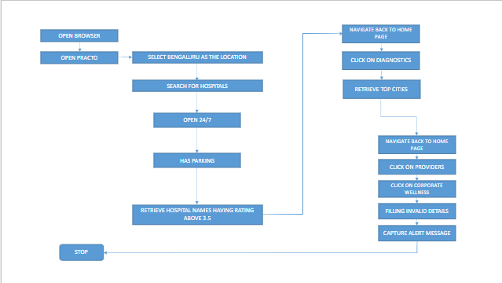
Work Flow

Slide 8
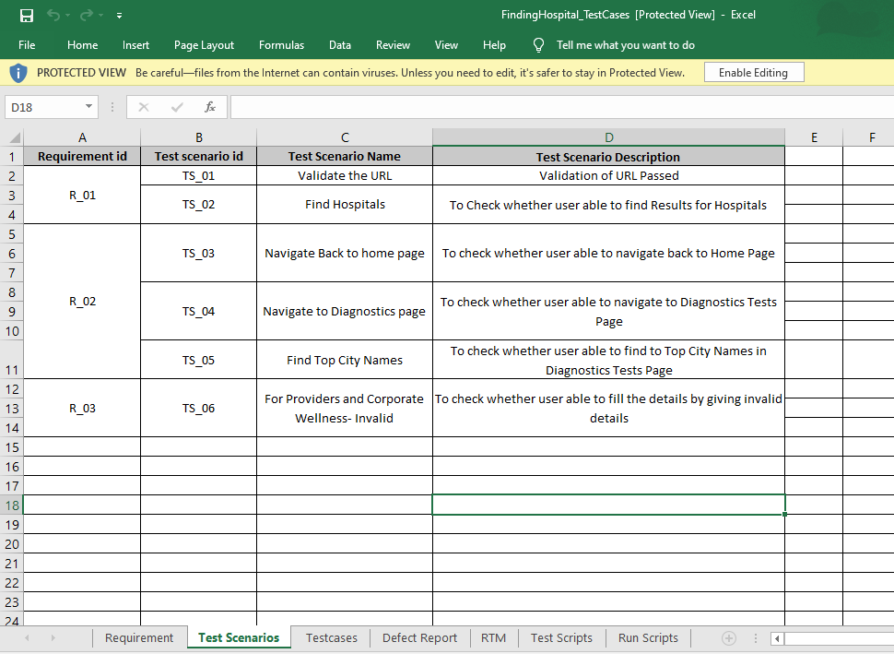
Test Scenarios

Slide 9
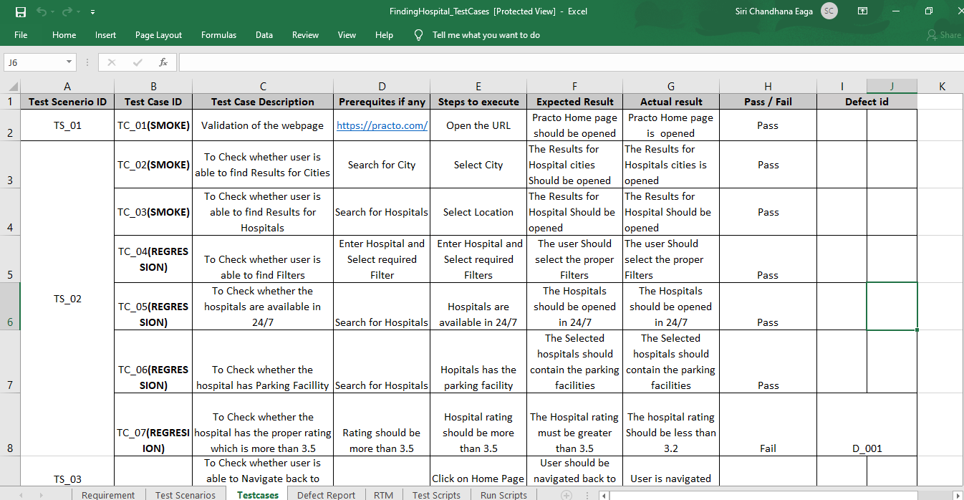
TestCases

Slide 10
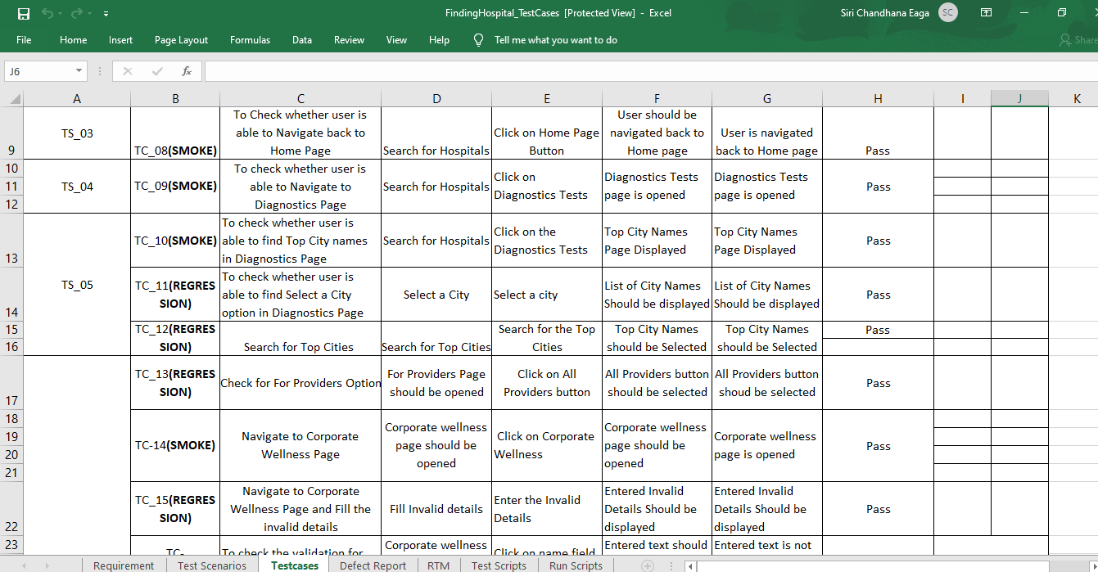

Slide 11

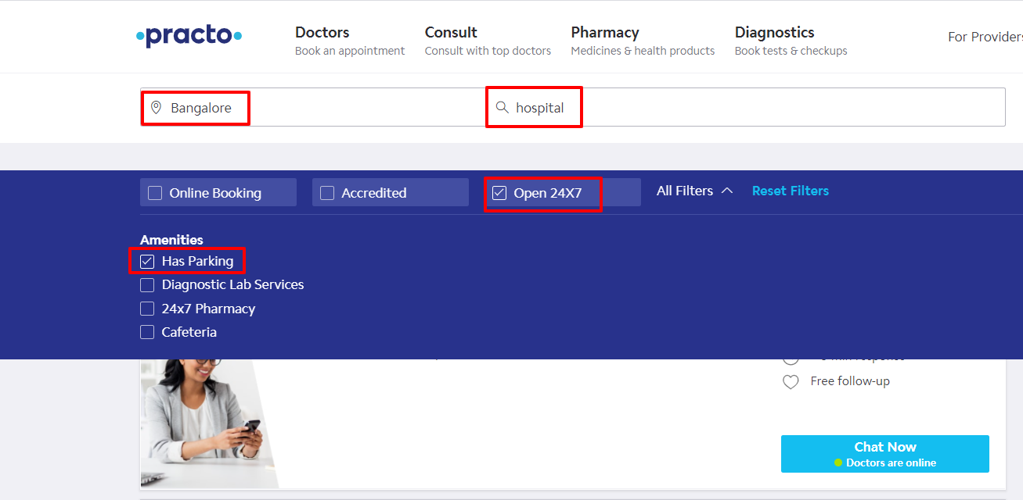
1
Select “Bangalore” and “Hospitals”. Check the “Open 24/7” check box. Apply “Has Parking Filter”

Slide 12
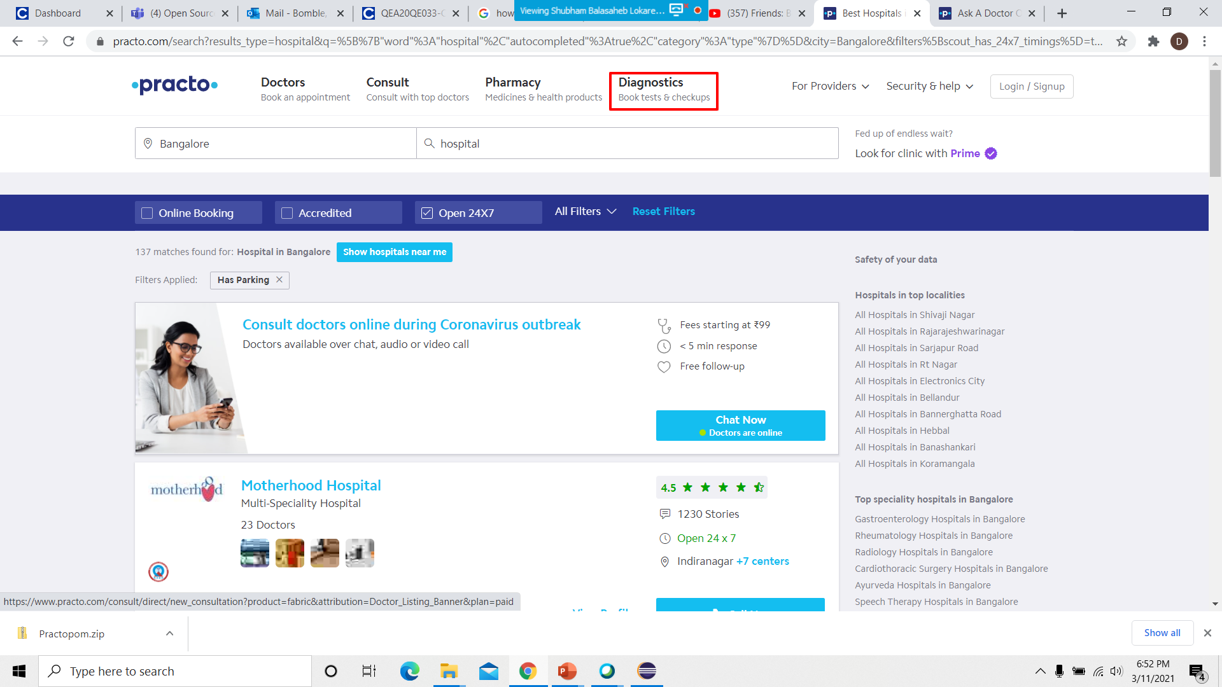
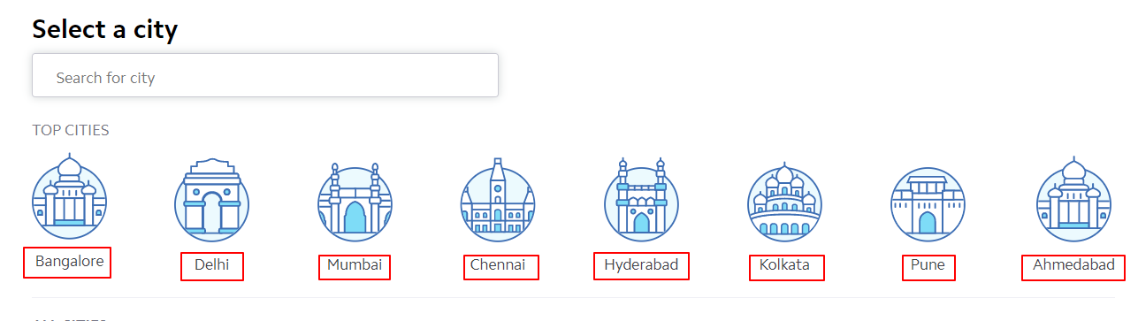
2
Select “Diagnostics” and display all the “Top Cities” name on the console.

Slide 13
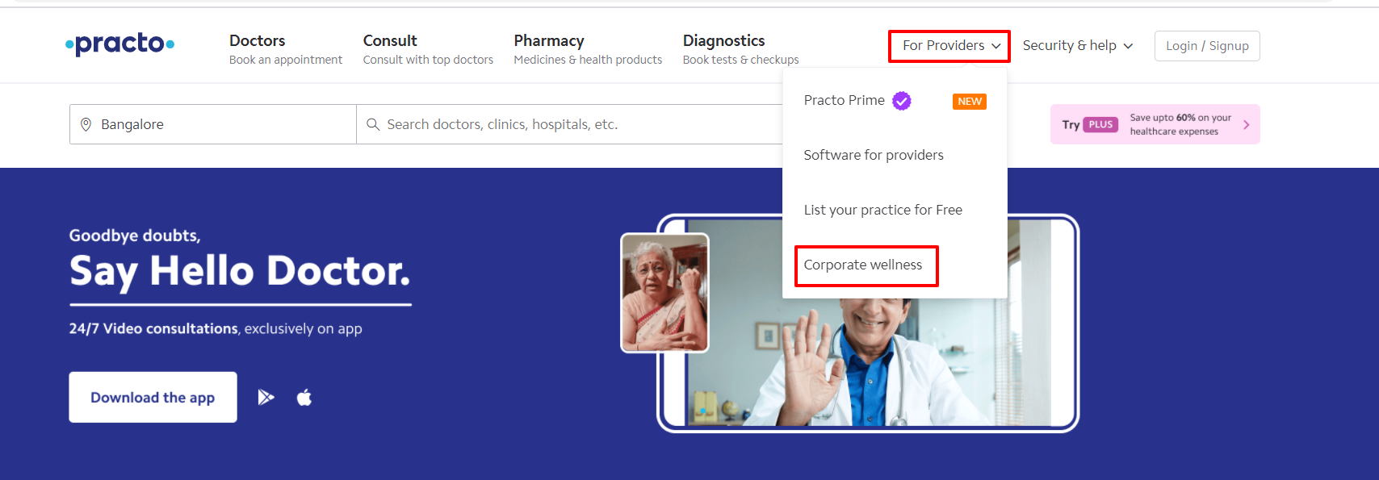
3
Select “For Providers”. From the drop down select “Corporate Wellness”.

Slide 14
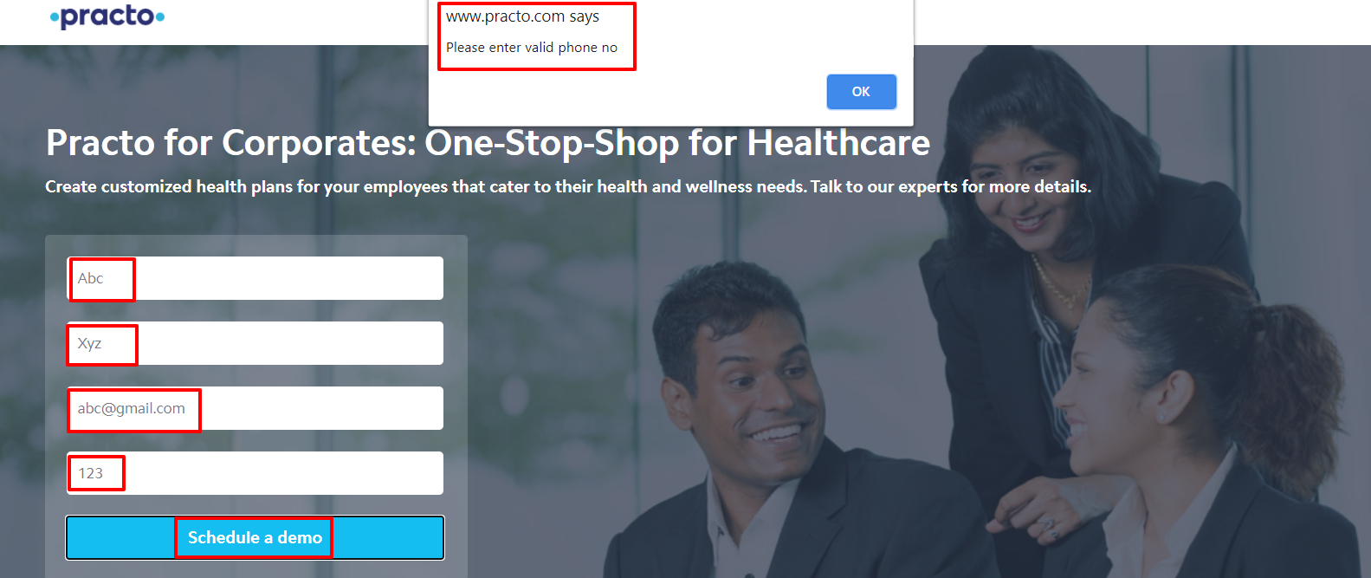
4
Give invalid details and “Schedule” it .Capture the “Alert” message.

Slide 15

THANK YOU.!

